Slide 1


ONLINE FURNITURE SYSTEM

Slide 2


Introduction
Problem Statement
LAYOUT
Aims and Objectives
Use Case
Conclusion

Slide 3
INTRODUCTION
An Online Furniture System brings the traditional furniture store into the digital age. It is a website that allows customers to browse and buy furniture from anywhere, at any time, solving the inconvenience of physical shopping. For the business, it provides a simple, centralized platform to manage products and orders efficiently.

Slide 4

PROBLEM STATEMENT
Inconvenient Shopping
Manual Errors
Limited Reach
Time Consumption

Slide 5


AIM
The main aim of the Online Furniture System is to make the furniture shopping process faster, easier, and more convenient by using a digital platform that improves customer access and tracks orders clearly.

Slide 6
Objectives
Our project objectives are to:
To build a secure login and registration system
To create a dynamic product catalog
To implement a fully functional shopping cart
To develop a simple checkout process
To construct an admin panel

Slide 7
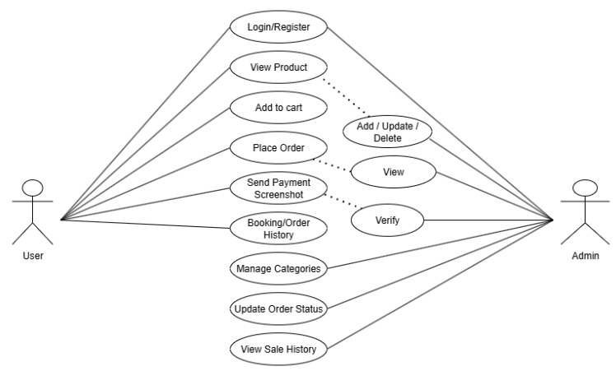
USECASE diagram

Slide 8
conclusion
In conclusion, an Online Furniture System is a smart solution to the limitations of traditional retail. It creates a win-win situation: customers get a more convenient way to shop, and the business gets a powerful tool to automate sales and management. Ultimately, it uses web technology to build a more efficient and accessible way to sell furniture.

Slide 9


